Slide 1
CNN

Slide 2
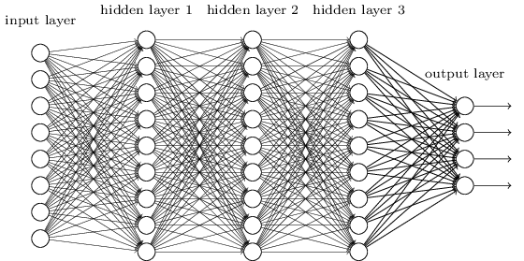
Convolutional Neural Network vs deep learning
We know it is good to learn a small model.
From this fully connected model, do we really need all the edges?
Can some of these be shared?

Slide 3
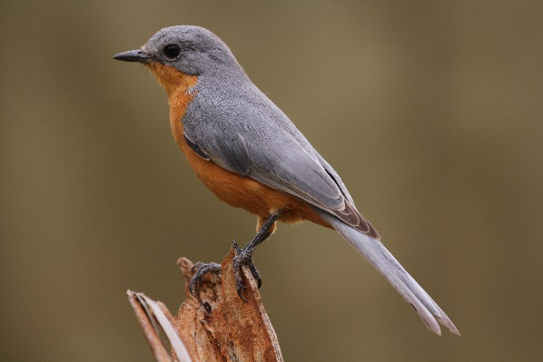
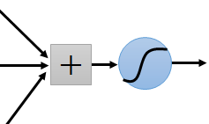
Consider learning an image:
Some patterns are much smaller than the whole image
Can represent a small region with fewer parameters
“beak” detector

Slide 4
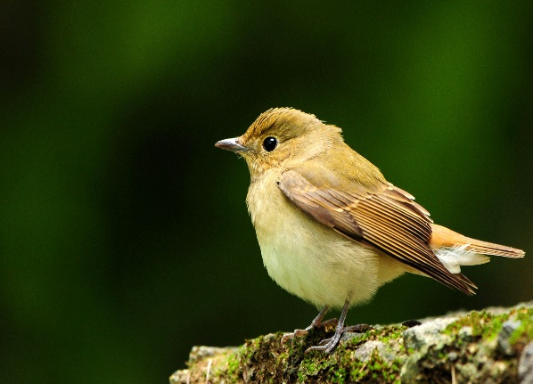
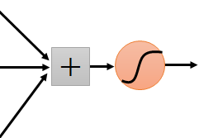
Same pattern appears in different places: They can be compressed! What about training a lot of such “small” detectors and each detector must “move around”.
“upper-left beak” detector
They can be compressed
to the same parameters.
“middle beak” detector

Slide 5
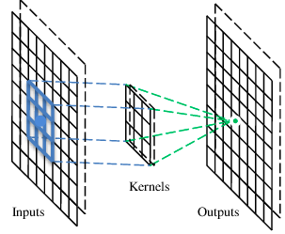
A convolutional layer
A CNN is a neural network with some convolutional layers
(and some other layers). A convolutional layer has a number
of filters that does convolutional operation.
Beak detector
A filter

Slide 6
Convolution
These are the network parameters to be learned.
1 | -1 | -1
-1 | 1 | -1
-1 | -1 | 1
1 | 0 | 0 | 0 | 0 | 1
0 | 1 | 0 | 0 | 1 | 0
0 | 0 | 1 | 1 | 0 | 0
1 | 0 | 0 | 0 | 1 | 0
0 | 1 | 0 | 0 | 1 | 0
0 | 0 | 1 | 0 | 1 | 0
Filter 1
-1 | 1 | -1
-1 | 1 | -1
-1 | 1 | -1
Filter 2
……
6 x 6 image
Each filter detects a small pattern (3 x 3).

Slide 7
Convolution
1 | -1 | -1
-1 | 1 | -1
-1 | -1 | 1
Filter 1
stride=1
1 | 0 | 0 | 0 | 0 | 1
0 | 1 | 0 | 0 | 1 | 0
0 | 0 | 1 | 1 | 0 | 0
1 | 0 | 0 | 0 | 1 | 0
0 | 1 | 0 | 0 | 1 | 0
0 | 0 | 1 | 0 | 1 | 0
Dot
product
3
-1
6 x 6 image

Slide 8
Convolution
1 | -1 | -1
-1 | 1 | -1
-1 | -1 | 1
Filter 1
If stride=2
1 | 0 | 0 | 0 | 0 | 1
0 | 1 | 0 | 0 | 1 | 0
0 | 0 | 1 | 1 | 0 | 0
1 | 0 | 0 | 0 | 1 | 0
0 | 1 | 0 | 0 | 1 | 0
0 | 0 | 1 | 0 | 1 | 0
3
-3
6 x 6 image

Slide 9
Convolution
1 | -1 | -1
-1 | 1 | -1
-1 | -1 | 1
Filter 1
stride=1
1 | 0 | 0 | 0 | 0 | 1
0 | 1 | 0 | 0 | 1 | 0
0 | 0 | 1 | 1 | 0 | 0
1 | 0 | 0 | 0 | 1 | 0
0 | 1 | 0 | 0 | 1 | 0
0 | 0 | 1 | 0 | 1 | 0
3
-1
-3
-1
-3
1
0
-3
-3
-3
0
1
3
-2
-2
-1
6 x 6 image

Slide 10
Convolution
-1 | 1 | -1
-1 | 1 | -1
-1 | 1 | -1
Filter 2
stride=1
Repeat this for each filter
1 | 0 | 0 | 0 | 0 | 1
0 | 1 | 0 | 0 | 1 | 0
0 | 0 | 1 | 1 | 0 | 0
1 | 0 | 0 | 0 | 1 | 0
0 | 1 | 0 | 0 | 1 | 0
0 | 0 | 1 | 0 | 1 | 0
3
-1
-3
-1
-1
-1
-1
-1
-3
1
0
-3
-1
-1
-2
1
Feature
Map
-3
-3
0
1
-1
-1
-2
1
3
-2
-2
-1
6 x 6 image
-1
0
-4
3
Two 4 x 4 images
Forming 2 x 4 x 4 matrix

Slide 11
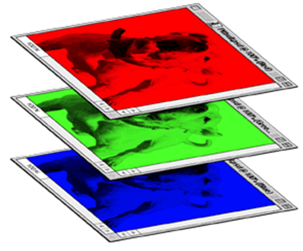
Color image: RGB 3 channels
1 | -1 | -1
-1 | 1 | -1
-1 | -1 | 1
-1 | 1 | -1
-1 | 1 | -1
-1 | 1 | -1
1 | -1 | -1
-1 | 1 | -1
-1 | -1 | 1
-1 | 1 | -1
-1 | 1 | -1
-1 | 1 | -1
1 | -1 | -1
-1 | 1 | -1
-1 | -1 | 1
-1 | 1 | -1
-1 | 1 | -1
-1 | 1 | -1
Filter 1
Filter 2
Color image
1 | 0 | 0 | 0 | 0 | 1
0 | 1 | 0 | 0 | 1 | 0
0 | 0 | 1 | 1 | 0 | 0
1 | 0 | 0 | 0 | 1 | 0
0 | 1 | 0 | 0 | 1 | 0
0 | 0 | 1 | 0 | 1 | 0
1 | 0 | 0 | 0 | 0 | 1
0 | 1 | 0 | 0 | 1 | 0
0 | 0 | 1 | 1 | 0 | 0
1 | 0 | 0 | 0 | 1 | 0
0 | 1 | 0 | 0 | 1 | 0
0 | 0 | 1 | 0 | 1 | 0
1 | 0 | 0 | 0 | 0 | 1
0 | 1 | 0 | 0 | 1 | 0
0 | 0 | 1 | 1 | 0 | 0
1 | 0 | 0 | 0 | 1 | 0
0 | 1 | 0 | 0 | 1 | 0
0 | 0 | 1 | 0 | 1 | 0

Slide 12
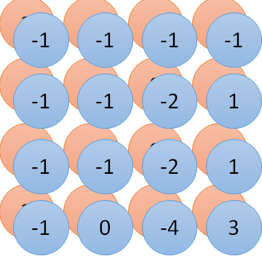
Convolution v.s. Fully Connected
1 | 0 | 0 | 0 | 0 | 1
0 | 1 | 0 | 0 | 1 | 0
0 | 0 | 1 | 1 | 0 | 0
1 | 0 | 0 | 0 | 1 | 0
0 | 1 | 0 | 0 | 1 | 0
0 | 0 | 1 | 0 | 1 | 0
1 | -1 | -1
-1 | 1 | -1
-1 | -1 | 1
-1 | 1 | -1
-1 | 1 | -1
-1 | 1 | -1
convolution
image
1 | 0 | 0 | 0 | 0 | 1
0 | 1 | 0 | 0 | 1 | 0
0 | 0 | 1 | 1 | 0 | 0
1 | 0 | 0 | 0 | 1 | 0
0 | 1 | 0 | 0 | 1 | 0
0 | 0 | 1 | 0 | 1 | 0
Fully-connected
……
……

Slide 13
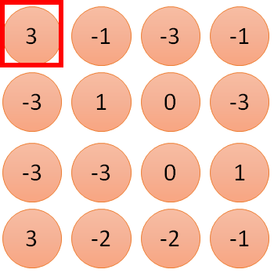
1 | -1 | -1
-1 | 1 | -1
-1 | -1 | 1
1
1
Filter 1
2
0
3
0
3
4:
0
1 | 0 | 0 | 0 | 0 | 1
0 | 1 | 0 | 0 | 1 | 0
0 | 0 | 1 | 1 | 0 | 0
1 | 0 | 0 | 0 | 1 | 0
0 | 1 | 0 | 0 | 1 | 0
0 | 0 | 1 | 0 | 1 | 0
…
0
8
1
9
0
10:
0
…
13
0
6 x 6 image
14
0
fewer parameters!
15
Only connect to 9 inputs, not fully connected
1
16
1
…

Slide 14
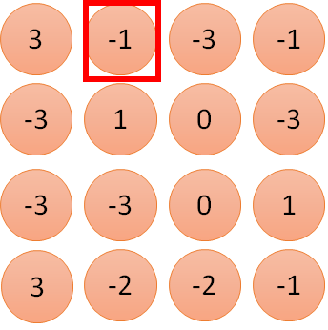
1 | -1 | -1
-1 | 1 | -1
-1 | -1 | 1
1:
1
Filter 1
2:
0
3:
0
3
4:
0
1 | 0 | 0 | 0 | 0 | 1
0 | 1 | 0 | 0 | 1 | 0
0 | 0 | 1 | 1 | 0 | 0
1 | 0 | 0 | 0 | 1 | 0
0 | 1 | 0 | 0 | 1 | 0
0 | 0 | 1 | 0 | 1 | 0
…
7:
0
8:
1
-1
9:
0
10:
0
…
13:
0
6 x 6 image
14:
0
Fewer parameters
15:
1
16:
1
Shared weights
Even fewer parameters
…

